Slide 1
The Basic Derivative Session 4-5
Course : MATH 6031 – Calculus
Year : 2021

Slide 2

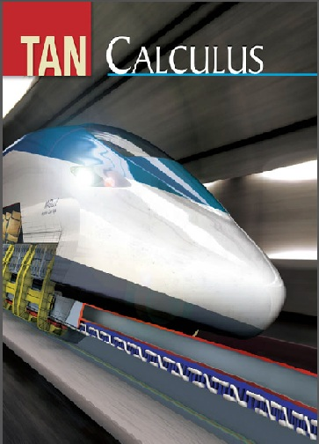
These slides have been adapted from: Dale Varberg, Edwin Purcell, Steve Rigdon. 2007. Calculus. Prentice Hall. ISBN: 978-0132306331. Soo.T.Tan. Calculus. 2010. Brooks/Cole. ISBN-13: 978-0-534-46579-7
Acknowledgement

Slide 3

Learning Objectives
LO 2:
Explain the properties of derivative to describe geometric and physical problems, and other applications.

Slide 4
Content
1
Two Problems with One Theme
2
The Derivative
3
Rules for Finding Derivatives
4
Derivatives of Trigonometric Functions
5
The Chain Rule

Slide 5
The Tangent Line
Definition Tangent Line
The tangent line to the curve $y=f(x)$ at the point $P\left(c,f\left(c\right)\right)$is that line through P with slope
$$m_{tan}=\lim_{h→0}{m_{sec}}=\lim_{h→0}{\frac{f\left(c+h\right)−f(c)}{h}}$$
Definition Tangent Line
The tangent line to the curve 𝑦=𝑓(𝑥) at the point 𝑃(𝑐,𝑓(𝑐))is that line through P with slope
𝑚_𝑡𝑎𝑛=lim_(ℎ→0)⁡〖𝑚_𝑠𝑒𝑐 〗=lim_(ℎ→0)⁡〖(𝑓(𝑐+ℎ)−𝑓(𝑐))/ℎ〗

Slide 6
Example 1
Graph
General Slope
The slope of the tangent lines to the curve
$$y=f\left(x\right)=−x^{2}+2x+2$$
at the point with x-coordinate c is:
The slope of the tangent lines to the curve
𝑦=𝑓(𝑥)=−𝑥^2+2𝑥+2
at the point with x-coordinate c is:
Indicated Slope
The slope of the tangent lines at the points with x-coordinates -1, ½, 2 and 3 obtained by letting c = -1, ½, 2 and 3.
Then we get the slope 4, 1, -2, -4, respectively.
$m=\lim_{h→0}{\frac{f\left(c+h\right)−f(c)}{h}}$
𝑚=lim┬(ℎ→0)⁡〖(𝑓(𝑐+ℎ)−𝑓(𝑐))/ℎ〗
$$=−2c+2$$
=−2𝑐+2

Slide 7
Instantaneous Velocity
If an object moves along a coordinate line with position function, then its instantaneous velocity at time c is
$$v=\lim_{h→0}{\frac{f\left(c+h\right)−f(c)}{h}}$$
provided that the limit exists and is not $∞$ or $−∞$.
If an object moves along a coordinate line with position function, then its instantaneous velocity at time c is
𝑣=lim┬(ℎ→0)⁡〖(𝑓(𝑐+ℎ)−𝑓(𝑐))/ℎ〗
provided that the limit exists and is not ∞ or −∞.
Definition

Slide 8
The Derivative
Definition
The derivative of a function f is another function f’ (read “f prime”)
Equivalent Forms
Note how x – c replaces h. Thus,
$$f^{′}\left(x\right)= \lim_{h→0}{\frac{f\left(x+h\right)−f(x)}{h}}$$
𝑓^′ (𝑥)= lim┬(ℎ→0)⁡〖(𝑓(𝑥+ℎ)−𝑓(𝑥))/ℎ〗
whose value at any number x is
$$f^{′}\left(c\right)= \lim_{h→0}{\frac{f\left(x\right)−f(c)}{h}}$$
𝑓^′ (𝑐)= lim┬(ℎ→0)⁡〖(𝑓(𝑥)−𝑓(𝑐))/ℎ〗

Slide 9
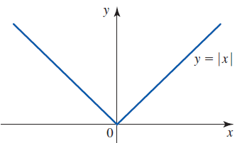
Differentiability
Theorem:
A function is said to be differentiable at a number if it has a derivative at that number.
Example:
If f(x) = |x|, then f is not differentiable at 0, because
$$\lim_{h→0}{\frac{f(0+h)−f(0)}{h}}=\lim_{h→0}{\frac{f(h)−f(0)}{h}}=\lim_{h→0}{\frac{|h|−0}{h}}=\lim_{h→0}{\frac{|h|}{h}}$$
as h approaches 0 are not equal:
$$\lim_{h→0^{−}}{\frac{|h|}{h}}=\lim_{h→0^{−}}{\frac{−h}{h}}=−1$$
$$\lim_{h→0^{+}}{\frac{|h|}{h}}=\lim_{h→0^{+}}{\frac{h}{h}}=1$$
Example:
If f(x) = |x|, then f is not differentiable at 0, because
lim┬(ℎ→0)⁡〖(𝑓(0+ℎ)−𝑓(0))/ℎ〗=lim┬(ℎ→0)⁡〖(𝑓(ℎ)−𝑓(0))/ℎ〗=lim┬(ℎ→0)⁡〖(|ℎ|−0)/ℎ〗=lim┬(ℎ→0)⁡〖(|ℎ|)/ℎ〗
as h approaches 0 are not equal:
lim┬(ℎ→0^− )⁡〖(|ℎ|)/ℎ〗=lim┬(ℎ→0^− )⁡〖(−ℎ)/ℎ〗=−1
lim┬(ℎ→0^+ )⁡〖(|ℎ|)/ℎ〗=lim┬(ℎ→0^+ )⁡〖ℎ/ℎ〗=1

Slide 10
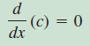
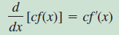
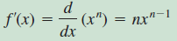
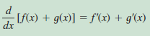
Some Basic Rules
1
2
3
4

Slide 11
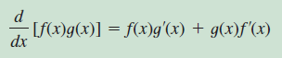
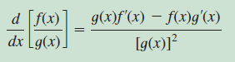
The Product and Quotient Rules
Product Rule
Quotient Rule

Slide 12
Example 2
1
$$y=\frac{x^{3}−2x^{2}+x−4}{2\sqrt{x}}$$
𝑦=(𝑥^3−2𝑥^2+𝑥−4)/(2√𝑥)
$$\frac{d}{dx}\left(\frac{x^{3}−2x^{2}+x−4}{2\sqrt{x}}\right) \\ =\frac{d}{dx}\left(\frac{1}{2}x^{5/2}−x^{\frac{3}{2}}+\frac{1}{2}x^{\frac{1}{2}} −2x^{−1/2}\right) \\ =\frac{5}{4}x^{3/2}−\frac{3}{2}x^{1/2}+\frac{1}{4}x^{−1/2}+x^{−3/2}$$
𝑑/𝑑𝑥 ((𝑥^3−2𝑥^2+𝑥−4)/(2√𝑥)) " "=𝑑/𝑑𝑥 (1/2 𝑥^(5/2)−𝑥^(3/2)+1/2 𝑥^(1/2) −2𝑥^(−1/2) ) " "=5/4 𝑥^(3/2)−3/2 𝑥^(1/2)+1/4 𝑥^(−1/2)+𝑥^(−3/2)
2
Suppose that g(x) =(x²+1)f(x) and it is known that f(2) = 3 and f’(2) = -1. Evaluate g’(2).
$$g′(x)$$
$$=\frac{d}{dx}\left[\left(x^{2}+1\right)f\left(x\right)\right]$$
$$=\left(x^{2}+1\right)\frac{d\left(f\left(x\right)\right)}{dx}$$
$+ f(x)\frac{d}{dx}(x^{2}+1)$ $$=(x^{2}+1)f′(x)+2xf(x)$$
Then $g^{′}\left(2\right)=7$
𝑔′(𝑥)
=𝑑/𝑑𝑥 [(𝑥^2+1)𝑓(𝑥)]
=(𝑥^2+1) 𝑑(𝑓(𝑥))/𝑑𝑥
+ 𝑓(𝑥)𝑑/𝑑𝑥(𝑥^2+1) " "=(𝑥^2+1)𝑓′(𝑥)+2𝑥𝑓(𝑥)
Then 𝑔^′ (2)=7

Slide 13
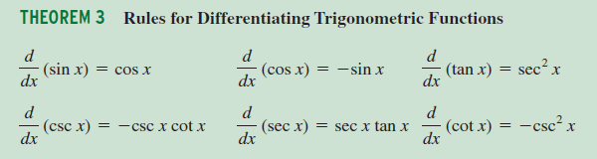
Derivatives of Trigonometric Functions

Slide 14


Example 3
Differentiate y = (sec x)(x + tan x)
Solution
Note:
$$\frac{dy}{dx}=\frac{d}{dx}\left[(\sec{x})(x+\tan{x})\right] \\ = (\sec{x})\frac{d(x+\tan{x})}{dx}+(x+\tan{x})\frac{d(\sec{x})}{dx} \\ =(\sec{x})(1+\sec^{2}{x})+(x+\tan{x})(\sec{x}\tan{x}) \\ =(\sec{x})(1+\sec^{2}{x}+x\tan{x}+\tan^{2}{x})=(\sec{x})(2+x\tan{x}+2\tan^{2}{x})$$
$$\sec^{2}{x}=1+\tan^{2}{x}$$

Slide 15
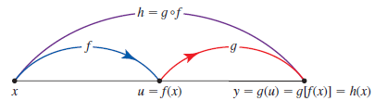
The Chain Rule
If is differentiable at x and g is differentiable at f(x), then the composition h = g o f defined by h(x) is differentiable at x, and
h’(x) = g’[f(x)]f’(x)
Also, if we write u = f(x) and y = g(u) = g[f(x)], then
$$\frac{dy}{dx}=\frac{dy}{du}⋅\frac{du}{dx}$$
Also, if we write u = f(x) and y = g(u) = g[f(x)], then
𝑑𝑦/𝑑𝑥=𝑑𝑦/𝑑𝑢⋅𝑑𝑢/𝑑𝑥

Slide 16
Example 4
If y = tan³(3x² + 1)
then

Slide 17
Dale Varberg, Edwin Purcell, Steve Rigdon. 2007. Calculus. Prentice Hall. ISBN: 978-0132306331.
Dale Varberg, Edwin Purcell, Steve Rigdon. 2014. Calculus Early Transcendentals. Pearson New International Edition. ISBN: 978-1-292-04268-8
Soo.T.Tan. 2010. Calculus. Brooks/Cole. ISBN-13: 978-0-534-46579-7

